Slide 1
Program Name goes here
Link to github Repository:
Links to trello board / project management tools:
You MUST provide evidence showing how the problem has been decomposed, how the components have been developed and trialled, and of how they have been assembled and tested to create a final, working outcome.

Slide 2
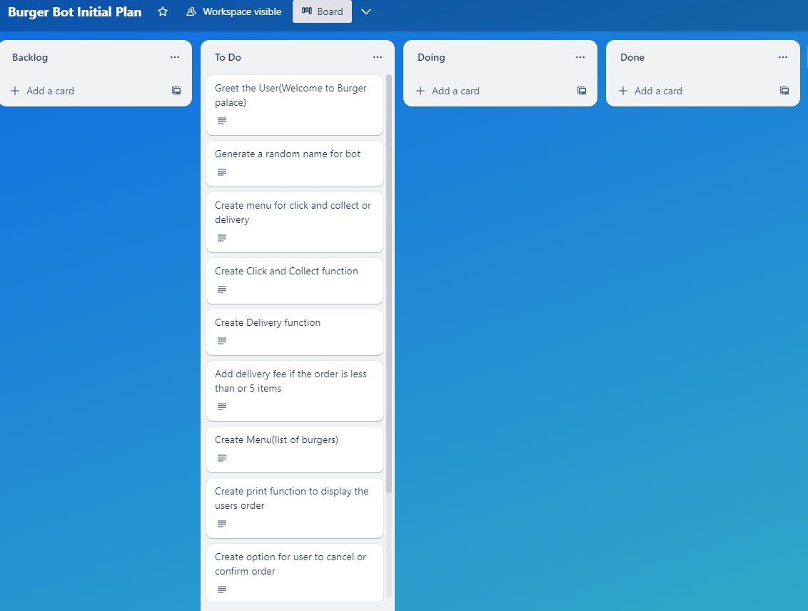
Decomposition 1 (Trello Screen Shot)

Slide 3
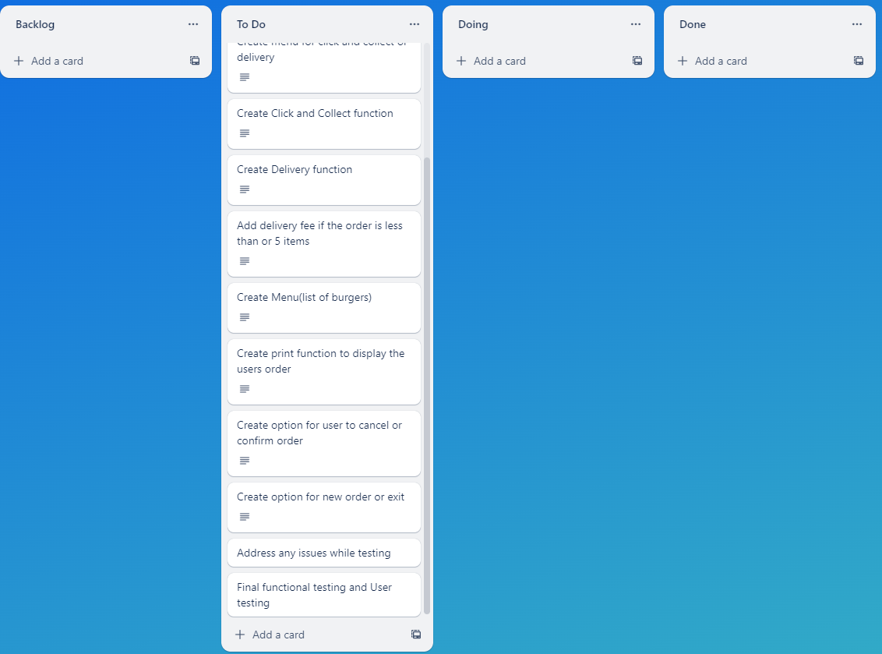
Decomposition 2 (Trello Screen Shot)

Slide 4
Relevant Implications
You must have at least 3. You can have more if you feel you need to consider more.

Slide 5
Explain the relevant implications
Implication 1
Describe the implication
Error recovery when the user has imputed something, and the program sends messages to send any solutions for the problem. So, the BOT must be able to find the problem and find a solution to it too.

Slide 6
Explain the relevant implications
Implication 1
Explain why it needs to be considered
Error recovery is important as the program needs to identify the issue and be able to help the user rather than the user searching through all the information and frustrating them. It is also import because if the program does not use error recovery the user might have to re-do the program and re-enter all the information

Slide 7
Explain the relevant implications
Implication 1
Explain how you plan to address the implication
To ensure the user can recover from errors I will be using value error code and the validation code to inform the user as soon as an incorrect or in-valid code has been entered

Slide 8
Explain the relevant implications
Implication 2
Describe the implication
The second implication is privacy. This implication addresses where someonw can leak ou information

Slide 9
Explain the relevant implications
Implication 2
Explain why it needs to be considered

Slide 10
Explain the relevant implications
Implication 2
Explain how you plan to address the implication

Slide 11
Explain the relevant implications
Implication 3
Describe the implication

Slide 12
Explain the relevant implications
Implication 3
Explain why it needs to be considered

Slide 13
Explain the relevant implications
Implication 3
Explain how you plan to address the implication

Slide 14
Decomposition
Paste screenshots of your initial Trello board / task decomposition on this slide. If you have a long list, you might need to break it up into several columns. Delete this instruction when you are done.
Notes:
Paste screenshots of your initial Trello board / task decomposition on this slide. If you have a long list, you might need to break it up into several columns. Delete this instruction when you are done.

Slide 15
Component Section
Duplicate Slides so that you have TRELLO and a TEST for each component

Slide 16
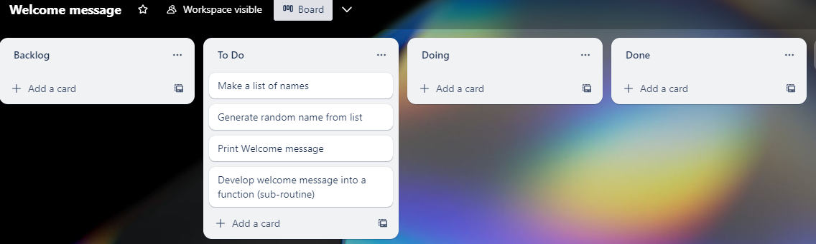
Component 1 (Trello screenshot)
Version 1

Slide 17
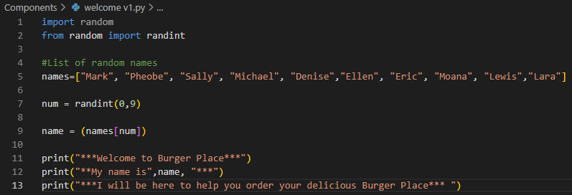

Component 1 – Welcome v1Test Plan (and screenshot)
Test Case | Expected Values
Run program to test | Print Welcome message with random names from list of names – Runs correctly

Slide 18
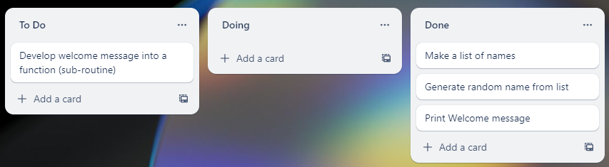
Component 1 v2 (Trello screenshot)

Slide 19
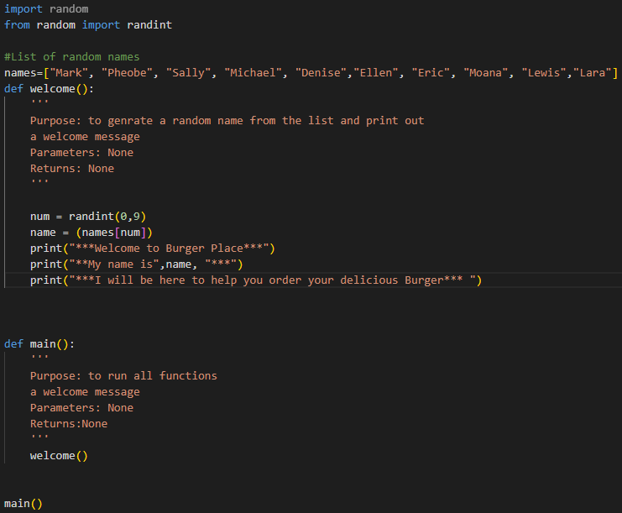
Component 1 – Welcome v2 Test Plan (and screenshot)
Test Case | Expected Values
Run program to test | Main and welcome run correctly. Welcome message prints with random name

Slide 20
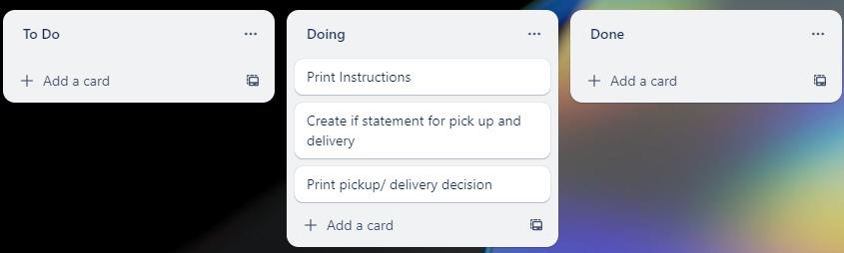
Component 2 Delivery/ click and collect Menu (Trello screenshot)

Slide 21
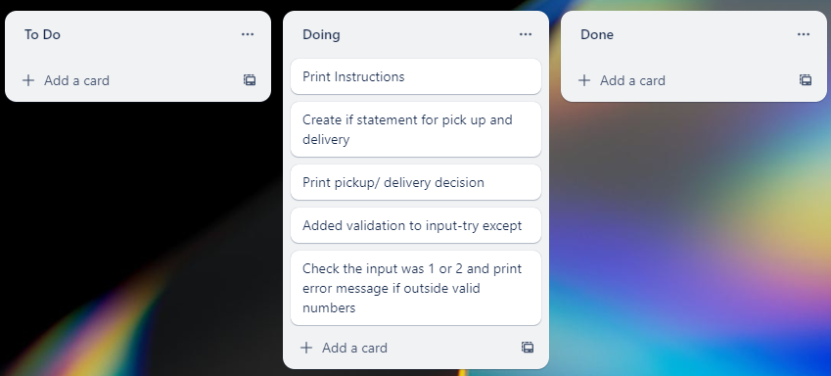
Component 2 Delivery/ click and collect Menu v2

Slide 22
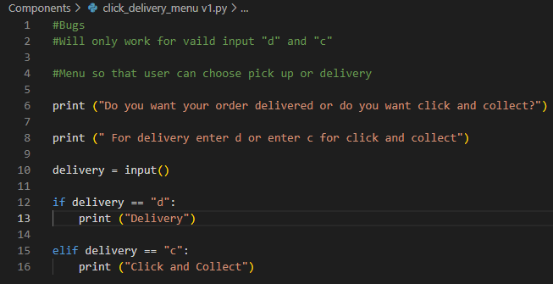
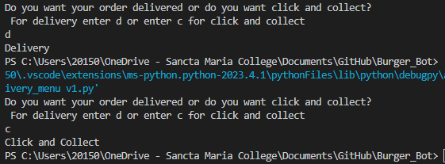
Component 2 - Test Plan v1(?and screenshot)
Test Case | Expected Values
Run Program | Enter c program prints pickup ​ Enter d program prints delivery​ Enter invalid program stops

Slide 23
Component 2 - Test Plan v2(?and screenshot)
Test Case | Expected Values
Run Program | Enter c program prints pickup ​ Enter d program prints delivery​ Enter invalid program stops

Slide 24
Component 3 (Trello screenshot)

Slide 25
Component 3 - Test Plan (?and screenshot)
Test Case | Expected Values

Slide 26
Component 4 (Trello screenshot)

Slide 27
Component 4 - Test Plan (?and screenshot)
Test Case | Expected Values

Slide 28
Component 5 (Trello screenshot)

Slide 29
Component 5 - Test Plan (?and screenshot)
Test Case | Expected Values

Slide 30
Component 6 (Trello screenshot)

Slide 31
Component 5 - Test Plan (?and screenshot)
Test Case | Expected Values

Slide 32
Version Control Section Section
Duplicate Slides if required – Show screenshot of GitHub commits and comments

Slide 33
Version Control Evidence
Your version control evidence should go here. This could be in the form of annotated screenshots which show you you managed this process or you could make a brief screencast explaining how you implemented version control.
Notes:
Your version control evidence should go here. This could be in the form of annotated screenshots which show you you managed this process or you could make a brief screencast explaining how you implemented version control.

Slide 34
Python Code Coventions
Show screenshot of PEP8 testing both before and after.

Slide 35
Python convention testing (PEP8)
Screenshot of errors
Notes:
Your version control evidence should go here. This could be in the form of annotated screenshots which show you you managed this process or you could make a brief screencast explaining how you implemented version control.

Slide 36
Python convention testing (PEP8)
Screenshot after errors fixed
Notes:
Your version control evidence should go here. This could be in the form of annotated screenshots which show you you managed this process or you could make a brief screencast explaining how you implemented version control.

Slide 37
Discusses how the information from planning, testing and trialling of components assisted in the development of a high-quality outcome
Notes:
Discusses how the information from planning, testing and trialling of components assisted in the development of a high-quality outcome

